Slide 1
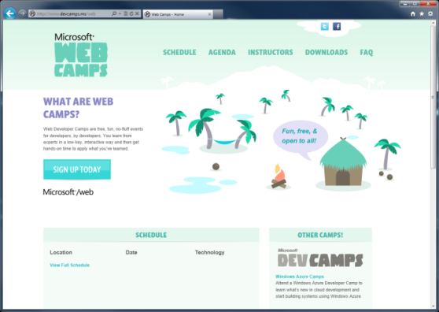

WebCamps Online
Twitter: Follow @webcamps Hashtag #webcamps
SPEAKER NAME/HANDLE HERE
Website: http://www.devcamps.ms/web
What are web camps?
Web Developer Camps are free, fun, no-fluff events for developers, by developers. You learn from experts in a low-key, interactive way and then get hands-on time to apply what you’ve learned.

Slide 2
Building Web Sites Using ASP.NET 4.5
Name
Title
Microsoft Corporation

Slide 3
ASP.NET: A Framework For All
HTML
XML
JSON
Web Forms
Razor View Engine
Code
Web Pages
MVC
MVC 4
Web API
ASP.NET Core
Self Host
Modules
Handlers
Membership
Intrinsics
Caching
Etc.
Notes:
Estimated Time: 2 minutes
No matter which type of developer you are, you get the benefit of the ASP.NET Core runtime, which provides many useful modules that provide functionality that you are likely to need when creating web applications. For example: Profile, Roles and Membership is important if you want to build in users and security around different parts of your website.
[Build x 3]
ASP.NET Web Forms, ASP.NET MVC and ASP.NET Web Pages are three different approaches to building web applications on the server side with ASP.NET. They all build on top of the same core runtime that provides them with the same powerful set of modules that web developers can leverage from within their web applications.
ASP.NET Web Forms is great for developers coming from desktop application development where they are accustomed to controls, event-driven development and code-behind. Despite not being concepts that are native to the web, Web Forms achieves this by abstracting away things like maintaining state, form posting and much more. This ease of development means that developers relinquish a certain amount of control as Web Forms manages communication between the server and client on your behalf.
ASP.NET MVC, in contrast, is for developers that like to be in full control of the interactions between client and server and provides a more “raw” approach to what happens in the web application. Due to its loosely coupled architecture, MVC is also very extensible with many places for developers to customize and plugin components as well write test code easily.
Developing in ASP.NET Web Pages is centered around inline code and is similar to PHP or classic ASP in that compilation of your application isn’t required (it is in WebForms and MVC). It is designed to provide the simplest approach to building websites with the fewest number of concepts to learn.
[Build x 2]
When it comes to controlling the markup that is rendered to the client there are two view engines you may use. The Web Forms view engine is shared by both Web Forms and MVC and uses the familiar <% %> syntax. With ASP.NET MVC 3 and ASP.NET Web Pages Microsoft introduced the Razor View Engine which uses a different syntax centered around the @ symbol. The Razor syntax uses fewer characters to achieve the same things in Web Forms and allows the developer to mix markup and code really easily.

Slide 4
The ASP.NET Core

Slide 5
Start with the core
HTML
XML
JSON
Web Forms
Razor View Engine
Code
Web Pages
MVC
MVC 4
Web API
ASP.NET Core
Self Host
Modules
Handlers
Membership
Intrinsics
Caching
Etc.
Notes:
Estimated Time: 2 minutes
No matter which type of developer you are, you get the benefit of the ASP.NET Core runtime, which provides many useful modules that provide functionality that you are likely to need when creating web applications. For example: Profile, Roles and Membership is important if you want to build in users and security around different parts of your website.
[Build x 3]
ASP.NET Web Forms, ASP.NET MVC and ASP.NET Web Pages are three different approaches to building web applications on the server side with ASP.NET. They all build on top of the same core runtime that provides them with the same powerful set of modules that web developers can leverage from within their web applications.
ASP.NET Web Forms is great for developers coming from desktop application development where they are accustomed to controls, event-driven development and code-behind. Despite not being concepts that are native to the web, Web Forms achieves this by abstracting away things like maintaining state, form posting and much more. This ease of development means that developers relinquish a certain amount of control as Web Forms manages communication between the server and client on your behalf.
ASP.NET MVC, in contrast, is for developers that like to be in full control of the interactions between client and server and provides a more “raw” approach to what happens in the web application. Due to its loosely coupled architecture, MVC is also very extensible with many places for developers to customize and plugin components as well write test code easily.
Developing in ASP.NET Web Pages is centered around inline code and is similar to PHP or classic ASP in that compilation of your application isn’t required (it is in WebForms and MVC). It is designed to provide the simplest approach to building websites with the fewest number of concepts to learn.
[Build x 2]
When it comes to controlling the markup that is rendered to the client there are two view engines you may use. The Web Forms view engine is shared by both Web Forms and MVC and uses the familiar <% %> syntax. With ASP.NET MVC 3 and ASP.NET Web Pages Microsoft introduced the Razor View Engine which uses a different syntax centered around the @ symbol. The Razor syntax uses fewer characters to achieve the same things in Web Forms and allows the developer to mix markup and code really easily.

Slide 6
Core to all
demo
Handlers, Modules, Request, Response, and so on

Slide 7
Web Forms 4.5

Slide 8
Web Forms is Continuing to Evolve
HTML
Web Forms
Model Binding
Unobtrusive Validation
Asynchronous Processing
ASP.NET Core
Modules
Handlers
Membership
Intrinsics
Caching
Etc.
Notes:
Estimated Time: 2 minutes
No matter which type of developer you are, you get the benefit of the ASP.NET Core runtime, which provides many useful modules that provide functionality that you are likely to need when creating web applications. For example: Profile, Roles and Membership is important if you want to build in users and security around different parts of your website.
[Build x 3]
ASP.NET Web Forms, ASP.NET MVC and ASP.NET Web Pages are three different approaches to building web applications on the server side with ASP.NET. They all build on top of the same core runtime that provides them with the same powerful set of modules that web developers can leverage from within their web applications.
ASP.NET Web Forms is great for developers coming from desktop application development where they are accustomed to controls, event-driven development and code-behind. Despite not being concepts that are native to the web, Web Forms achieves this by abstracting away things like maintaining state, form posting and much more. This ease of development means that developers relinquish a certain amount of control as Web Forms manages communication between the server and client on your behalf.
ASP.NET MVC, in contrast, is for developers that like to be in full control of the interactions between client and server and provides a more “raw” approach to what happens in the web application. Due to its loosely coupled architecture, MVC is also very extensible with many places for developers to customize and plugin components as well write test code easily.
Developing in ASP.NET Web Pages is centered around inline code and is similar to PHP or classic ASP in that compilation of your application isn’t required (it is in WebForms and MVC). It is designed to provide the simplest approach to building websites with the fewest number of concepts to learn.
[Build x 2]
When it comes to controlling the markup that is rendered to the client there are two view engines you may use. The Web Forms view engine is shared by both Web Forms and MVC and uses the familiar <% %> syntax. With ASP.NET MVC 3 and ASP.NET Web Pages Microsoft introduced the Razor View Engine which uses a different syntax centered around the @ symbol. The Razor syntax uses fewer characters to achieve the same things in Web Forms and allows the developer to mix markup and code really easily.

Slide 9
Model Binding with ASP.NET Web Forms
Step 1:
Set the ItemType
<ul>
<asp:Repeater ID="customersRepeater" runat="server"
ItemType="WebFormsLab.Model.Customer">
</asp:Repeater>
</ul>
Step 2:
Reference the properties as needed using the Item keyword
<ul>
<asp:Repeater ID="customersRepeater" runat="server“ ItemType="WebFormsLab.Model.Customer">
<ItemTemplate>
<li>
<a href="CustomerDetails.aspx?id=<%#: Item.Id %>">
<%#: Item.FirstName %> <%#: Item.LastName %>
</a>
</li>
</ItemTemplate>
</asp:Repeater>
</ul>
Notes:
1 minute
The transition from code to markup is one of the most elegant things about Razor but there a few rules that are worth knowing about.
Option 1:
Code is the primary citizen in a code block, not HTML. This means the parser will always expect code unless it finds valid opening (and closing) tags. In the first option block you see that after the @{ a name variable is defined. No additional tag is necessary.
A <div> section tells Razor that what follows should be taken as literal. Then the @name indicates a variable that needs to be replaced with its value.
Option 2:
Similarly, to explicitly call out text in a code block as HTML, wrap it in a <text> tag
Option 3:
Single line of output within markup can be denoted by @:
This option is useful when you don’t want to render an HTML element as part of the output.
Extra Knowledge (Advanced):
The Parser that understands Razor is itself a standalone assembly (System.Web.Razor.dll) which has no dependencies on ASP.NET which means you can use it to parse CSHTML/VBHTML files and produce C#/VB code in any .NET application.

Slide 10
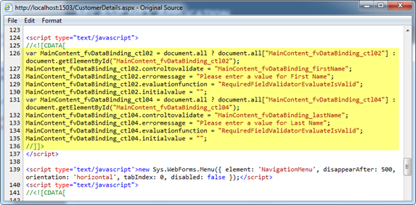
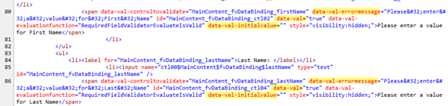
Unobtrusive Validation
The old way uses lots of JavaScript and HTML code that’s not very clean
The new way uses a lot less JavaScript and makes use of HTML5 semantic attributes
Notes:
Estimated Time: 3 minutes
[Potential Questions to ask the audience:]
Who is using raw SQL script today to access their database? Why?
Who is using stored procedures? Why?
Who is using ORM?
For a long time in the history of programming, the data abstractions that represented the business objects were designed as database objects and were expressed in Entity-Relationship diagrams. This led to databases having great influence on the entity data model that was generated afterwards based on the existing database objects.
Then, software engineering evolved and the design focus was transmuted from the database to the software implementation. This lead to a whole new paradigm, where the entity data model were designed first, based on the user needs, and the database objects has to adapt to it.
The Entity Framework abstracts the database away from the application by providing sets of entities with which to work. Instead of talking to the database, the application developer speaks “entities” and the framework manages all of the database communications on behalf of the developer.

Slide 11
New Web Forms Features
demo

Slide 12
Web Pages

Slide 13
Web Pages – HTML + Razor Syntax
HTML
Web Forms
Razor View Engine
Web Pages
ASP.NET Core
Modules
Handlers
Membership
Intrinsics
Caching
Etc.
Notes:
Estimated Time: 2 minutes
No matter which type of developer you are, you get the benefit of the ASP.NET Core runtime, which provides many useful modules that provide functionality that you are likely to need when creating web applications. For example: Profile, Roles and Membership is important if you want to build in users and security around different parts of your website.
[Build x 3]
ASP.NET Web Forms, ASP.NET MVC and ASP.NET Web Pages are three different approaches to building web applications on the server side with ASP.NET. They all build on top of the same core runtime that provides them with the same powerful set of modules that web developers can leverage from within their web applications.
ASP.NET Web Forms is great for developers coming from desktop application development where they are accustomed to controls, event-driven development and code-behind. Despite not being concepts that are native to the web, Web Forms achieves this by abstracting away things like maintaining state, form posting and much more. This ease of development means that developers relinquish a certain amount of control as Web Forms manages communication between the server and client on your behalf.
ASP.NET MVC, in contrast, is for developers that like to be in full control of the interactions between client and server and provides a more “raw” approach to what happens in the web application. Due to its loosely coupled architecture, MVC is also very extensible with many places for developers to customize and plugin components as well write test code easily.
Developing in ASP.NET Web Pages is centered around inline code and is similar to PHP or classic ASP in that compilation of your application isn’t required (it is in WebForms and MVC). It is designed to provide the simplest approach to building websites with the fewest number of concepts to learn.
[Build x 2]
When it comes to controlling the markup that is rendered to the client there are two view engines you may use. The Web Forms view engine is shared by both Web Forms and MVC and uses the familiar <% %> syntax. With ASP.NET MVC 3 and ASP.NET Web Pages Microsoft introduced the Razor View Engine which uses a different syntax centered around the @ symbol. The Razor syntax uses fewer characters to achieve the same things in Web Forms and allows the developer to mix markup and code really easily.

Slide 14
Razor Syntax
@if (User.Grok(Razor)) {
<div>w00t!</div>
}
New, Simplified View Engine
Write fewer lines of code
More natural mix code and markup
Helpers save you time
Compatible with ASP.NET Web Pages in WebMatrix
Notes:
Note – only use this slide if you are using ASP.NET MVC 3
With ASP.NET MVC 3 we’ve added a new view engine which uses a new lightweight syntax called Razor. Razor is designed to make it easier and faster to write code and allows you to mix markup and code for more understandable views.
The new syntax is characterized by the new @ symbol that you will see commonly in Razor views and allows you to mix code and markup freely, which makes for much cleaner code.
Razor also allows you to make use of “Helpers” which are shortcuts that make it easier to use common plugins like ReCapture, Facebook Social Plugins, OData etc.
The Razor syntax is actually borrowed from the younger sibling of MVC, ASP.NET Web Pages, with a few modifications that are added on top. For example MVC adds the @model keyword so that you no longer have to specify the full namespace in your directive when you are referencing models or ViewModels.

Slide 15
Move From Code to Markup Easily with Razor
Option 1:
HTML Block
@{
var name = “John Doe”;
<div>
Your name: @name
</div>
}
Option 2:
Text Block
@{
var name = “John Doe”;
<text>
Your name: @name
</text>
}
Option 3:
Single line of output in markup
@{
var name = “John Doe”;
@: Your name: @name
}
Notes:
1 minute
The transition from code to markup is one of the most elegant things about Razor but there a few rules that are worth knowing about.
Option 1:
Code is the primary citizen in a code block, not HTML. This means the parser will always expect code unless it finds valid opening (and closing) tags. In the first option block you see that after the @{ a name variable is defined. No additional tag is necessary.
A <div> section tells Razor that what follows should be taken as literal. Then the @name indicates a variable that needs to be replaced with its value.
Option 2:
Similarly, to explicitly call out text in a code block as HTML, wrap it in a <text> tag
Option 3:
Single line of output within markup can be denoted by @:
This option is useful when you don’t want to render an HTML element as part of the output.
Extra Knowledge (Advanced):
The Parser that understands Razor is itself a standalone assembly (System.Web.Razor.dll) which has no dependencies on ASP.NET which means you can use it to parse CSHTML/VBHTML files and produce C#/VB code in any .NET application.

Slide 16
ASP.NET MVC 4

Slide 17
MVC is Another Alternative in the Stack
HTML
Web Forms
Razor View Engine
Web Pages
MVC
MVC 4
ASP.NET Core
Modules
Handlers
Membership
Intrinsics
Caching
Etc.
Notes:
Estimated Time: 2 minutes
No matter which type of developer you are, you get the benefit of the ASP.NET Core runtime, which provides many useful modules that provide functionality that you are likely to need when creating web applications. For example: Profile, Roles and Membership is important if you want to build in users and security around different parts of your website.
[Build x 3]
ASP.NET Web Forms, ASP.NET MVC and ASP.NET Web Pages are three different approaches to building web applications on the server side with ASP.NET. They all build on top of the same core runtime that provides them with the same powerful set of modules that web developers can leverage from within their web applications.
ASP.NET Web Forms is great for developers coming from desktop application development where they are accustomed to controls, event-driven development and code-behind. Despite not being concepts that are native to the web, Web Forms achieves this by abstracting away things like maintaining state, form posting and much more. This ease of development means that developers relinquish a certain amount of control as Web Forms manages communication between the server and client on your behalf.
ASP.NET MVC, in contrast, is for developers that like to be in full control of the interactions between client and server and provides a more “raw” approach to what happens in the web application. Due to its loosely coupled architecture, MVC is also very extensible with many places for developers to customize and plugin components as well write test code easily.
Developing in ASP.NET Web Pages is centered around inline code and is similar to PHP or classic ASP in that compilation of your application isn’t required (it is in WebForms and MVC). It is designed to provide the simplest approach to building websites with the fewest number of concepts to learn.
[Build x 2]
When it comes to controlling the markup that is rendered to the client there are two view engines you may use. The Web Forms view engine is shared by both Web Forms and MVC and uses the familiar <% %> syntax. With ASP.NET MVC 3 and ASP.NET Web Pages Microsoft introduced the Razor View Engine which uses a different syntax centered around the @ symbol. The Razor syntax uses fewer characters to achieve the same things in Web Forms and allows the developer to mix markup and code really easily.

Slide 18
ASP.NET MVC 101
Model
(Data)
Controller
(Input)
View
(Presentation)
Notes:
Estimated Time: 2 minutes
MVC is a design pattern that stands for Model-View-Controller. What is strives to do is separate the concerns of an application’s presentation layer by assigning specific roles to the three different components.
The Controller is responsible for handling all user input. Once input has been received, the Controller will perform any operations/actions it needs to, which might include interacting with the Model.
The Model represents the data in the application. Once the Controller retrieves some model data and performs any work with the model, it constructs a presentation model that describes the model in terms the View can understand.
The View is the visual representation of the model. It presents the model data to the actual user in a way that is meaningful. In a web application, this would typically be HTML.

Slide 19
How MVC Works
What does MVC look like?
Request
Controller
Controller
Retrieves Model
“Does Stuff”
Response
View
View
Visually represents
the model
Notes:
Estimated Time: 4 minutes
So what does MVC look like when implemented over the web?
When an HTTP request comes into the application it is mapped to a controller. Remember as we mentioned in the previous slide, in the MVC design pattern, the controller is the piece of the triad that handles all user input. In the case of a web application, user input is represented as HTTP requests [Advance Animation].
Once the controller has received input, it performs whatever operations it needs to and then assembles a presentation model [Advance Animation].
The controller then takes the model and passes it off to the view. Remember that the view is simply a visual representation of the model [Advance Animation].
The view then “transforms” the model into whatever format it uses to represent it. In a web application, this would typically be HTML [Advance Animation].
The view then serves the request by responding with its visual representation.

Slide 20
Supported Dependency Injection Points
Controllers
registering & injecting controller factories
injecting controllers
Views
registering & injecting view engines
injecting dependencies into view pages
Action Filters
locating & injecting filters
Model Binders
registering & injecting
Value Providers
registering & injecting
Validation Providers
registering & injecting
Model metadata Providers
registering & injecting
Notes:
The following table shows some of the dependency injection points supported.

Slide 21
ASP.NET MVC Fundamentals
demo
Notes:
See demo script for details

Slide 22
Web API

Slide 23
Web API – Once Missing in ASP.NET
HTML
XML
JSON
Web Forms
Razor View Engine
Code
Web Pages
MVC
MVC 4
Web API
ASP.NET Core
Self Host
Modules
Handlers
Membership
Intrinsics
Caching
Etc.
Notes:
Estimated Time: 2 minutes
No matter which type of developer you are, you get the benefit of the ASP.NET Core runtime, which provides many useful modules that provide functionality that you are likely to need when creating web applications. For example: Profile, Roles and Membership is important if you want to build in users and security around different parts of your website.
[Build x 3]
ASP.NET Web Forms, ASP.NET MVC and ASP.NET Web Pages are three different approaches to building web applications on the server side with ASP.NET. They all build on top of the same core runtime that provides them with the same powerful set of modules that web developers can leverage from within their web applications.
ASP.NET Web Forms is great for developers coming from desktop application development where they are accustomed to controls, event-driven development and code-behind. Despite not being concepts that are native to the web, Web Forms achieves this by abstracting away things like maintaining state, form posting and much more. This ease of development means that developers relinquish a certain amount of control as Web Forms manages communication between the server and client on your behalf.
ASP.NET MVC, in contrast, is for developers that like to be in full control of the interactions between client and server and provides a more “raw” approach to what happens in the web application. Due to its loosely coupled architecture, MVC is also very extensible with many places for developers to customize and plugin components as well write test code easily.
Developing in ASP.NET Web Pages is centered around inline code and is similar to PHP or classic ASP in that compilation of your application isn’t required (it is in WebForms and MVC). It is designed to provide the simplest approach to building websites with the fewest number of concepts to learn.
[Build x 2]
When it comes to controlling the markup that is rendered to the client there are two view engines you may use. The Web Forms view engine is shared by both Web Forms and MVC and uses the familiar <% %> syntax. With ASP.NET MVC 3 and ASP.NET Web Pages Microsoft introduced the Razor View Engine which uses a different syntax centered around the @ symbol. The Razor syntax uses fewer characters to achieve the same things in Web Forms and allows the developer to mix markup and code really easily.

Slide 24
Web API
How can you expose your site’s reach to devices or do B2B?
Now you can expose your site’s reach to devices or do B2B
A RESTful, HTTP-considerate interface
Previously WCF Web API, rebuilt as part of MVC
More consistent with the MVC approach
JSON and XML support out-of-the-box
Custom formatter support available

Slide 25
A simple API in 5 steps
Step 1:
Create a Model
public class Person
{
public int Id { get; set; }
public string Name { get; set; }
}
Step 2:
Make an API Controller
public class PersonController : ApiController
{
List<Person> _people;
public PersonController()
{
_people = new List<Person>();
_people.AddRange(new Person[]
{
new Person { Id = 1, Name = "Chuck Norris" },
new Person { Id = 2, Name = "David Caradine" },
new Person { Id = 3, Name = "Bruce Lee" }
});
}
}
Notes:
1 minute
The transition from code to markup is one of the most elegant things about Razor but there a few rules that are worth knowing about.
Option 1:
Code is the primary citizen in a code block, not HTML. This means the parser will always expect code unless it finds valid opening (and closing) tags. In the first option block you see that after the @{ a name variable is defined. No additional tag is necessary.
A <div> section tells Razor that what follows should be taken as literal. Then the @name indicates a variable that needs to be replaced with its value.
Option 2:
Similarly, to explicitly call out text in a code block as HTML, wrap it in a <text> tag
Option 3:
Single line of output within markup can be denoted by @:
This option is useful when you don’t want to render an HTML element as part of the output.
Extra Knowledge (Advanced):
The Parser that understands Razor is itself a standalone assembly (System.Web.Razor.dll) which has no dependencies on ASP.NET which means you can use it to parse CSHTML/VBHTML files and produce C#/VB code in any .NET application.

Slide 26
Make Controller actions to return & save data
Step 3:
Return everything
// GET /api/person
public IEnumerable<Person> Get()
{
return _people;
}
Step 4:
Return one item
// GET /api/person/5
public Person Get(int id)
{
return _people.First(x => x.Id == id);
}
Step 5:
Collect an item
// POST /api/person
public void Post(Person value)
{
_people.Add(value);
}
Notes:
1 minute
The transition from code to markup is one of the most elegant things about Razor but there a few rules that are worth knowing about.
Option 1:
Code is the primary citizen in a code block, not HTML. This means the parser will always expect code unless it finds valid opening (and closing) tags. In the first option block you see that after the @{ a name variable is defined. No additional tag is necessary.
A <div> section tells Razor that what follows should be taken as literal. Then the @name indicates a variable that needs to be replaced with its value.
Option 2:
Similarly, to explicitly call out text in a code block as HTML, wrap it in a <text> tag
Option 3:
Single line of output within markup can be denoted by @:
This option is useful when you don’t want to render an HTML element as part of the output.
Extra Knowledge (Advanced):
The Parser that understands Razor is itself a standalone assembly (System.Web.Razor.dll) which has no dependencies on ASP.NET which means you can use it to parse CSHTML/VBHTML files and produce C#/VB code in any .NET application.

Slide 27
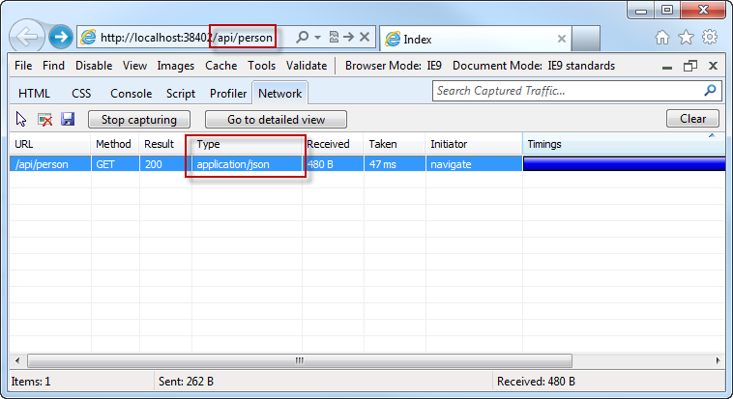
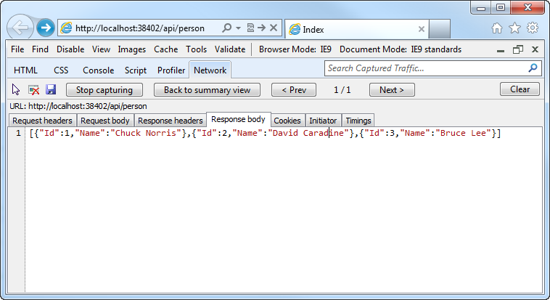
Testing Web API with IE9
Go to /api/person ([prefix]Controller)
Detailed view exposes the JSON data
All of this, using native HTTP calls and familiar MVC syntax!

Slide 28
Building an API
demo

Slide 29
Summary
There is One ASP.NET Framework on top of which many cool things are built
New features of ASP.NET Web Forms 4.5
Web Pages and Razor
New Features in MVC 4
Web API

Slide 30

Resources
Feedback and questions http://forums.dev.windows.com
ASP.NET Web Site http://asp.net
ASP.NET Web API Site http://asp.net/web-api

